Slide 1
Tricarboxylic Acid Cycle
(Krebs or citric acid cycle)
INTER 111: Graduate Biochemistry

Slide 2
Tricarboxylic acid cycle: learning objectives
To discuss the function of the citric acid cycle in intermediary metabolism, where it occurs in the cell, and how pyruvate is converted into acetyl coA and enters the cycle.
Be able to write down the structures and names of the CAC intermediates and the name of the enzyme catalyzing each step.
Understand and be able to write down the net reaction of the citric acid cycle.
Be able to name all the steps in the citric acid cycle in which reduced NAD or reduced FAD is formed.
Be able to name all the decarboxylation steps in the citric acid cycle.
To describe and discuss the regulation of the citric acid cycle.
To describe and discuss how the citric acid cycle functions as the final common pathway for the oxidation of polysaccharides, proteins, and lipids.

Slide 3
TCA cycle oxidizes organic molecules under aerobic conditions
Function is to oxidize organic molecules under aerobic conditions.
8 reactions in cycle
Pyruvate is degraded to CO₂.
1 GTP (ATP in bacteria) and 1 FADH₂ are produced during one turn of the cycle.
3 NADH are produced during one turn of the cycle.
Reducing equivalents of NADH and FADH₂ are used in ETC and oxidative phosphorylation.

Slide 4
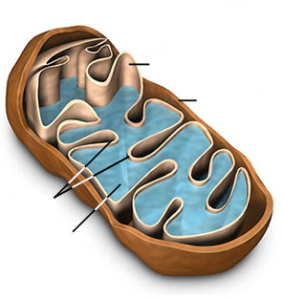
A pyruvate transporter carries cytoplasmic pyruvate to the mitochondrial matrix
impermeable to most small ions & molecules
inner membrane
outer membrane
NAD⁺
cristae
a
FMN
CoQ
c
b
matrix
a₃
a
contains TCA cycle enzymes, fatty acid oxidation enzymes, mtDNA, mtRNA, mitochondrial ribosomes

Slide 5
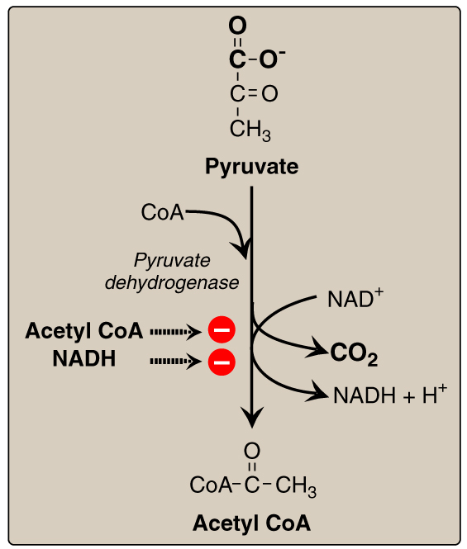
Pyruvate dehydrogenase complex decarboxylates pyruvate to acetyl coA
Pyruvate dehydrogenase complex ‘links’ glycolysis to the citric acid cycle.

Slide 6
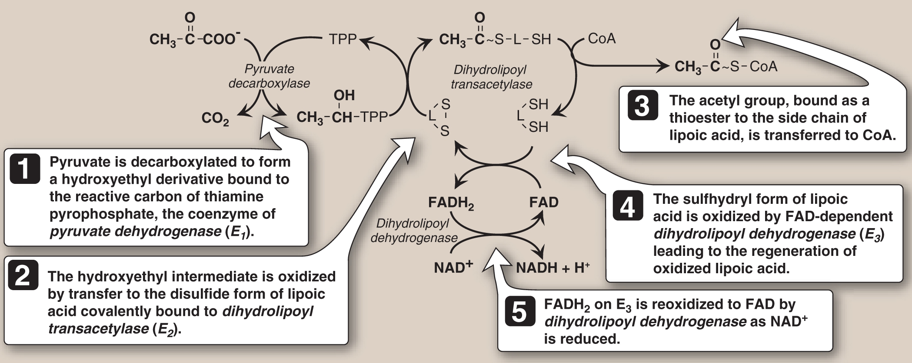
Pyruvate dehydrogenase complex contains 3 types of subunits & 5 coenzymes
~ 4.6 MDa assembly of 60 polypeptides held together by non-covalent forces

Slide 7
Pyruvate dehydrogenase complex is highly regulated

Slide 8
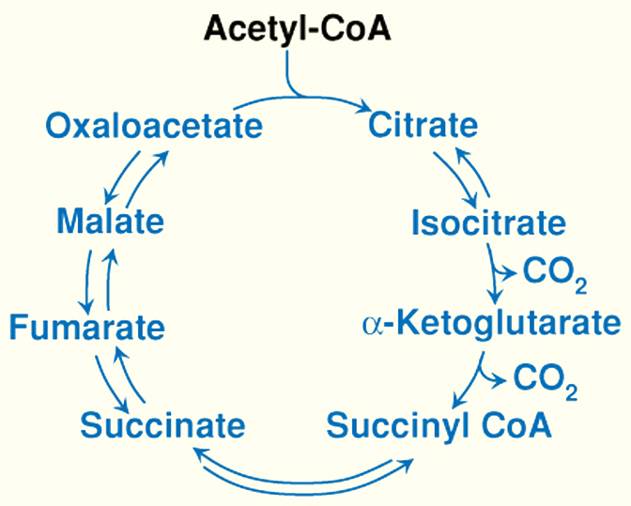
Overview of TCA cycle
C-2
condensation
C-4
C-6
isomerization
NADH
C-6
C-4
decarboxylation
+ NADH
C-4
C-5
FADH₂
decarboxylation
+ NADH
C-4
GTP
C-4

Slide 9
Overview of TCA cycle
citrate synthase
malate
dehydrogenase
aconitase
NADH
isocitrate dehydrogenase
+ NADH
fumarase
succinate dehydrogenase
FADH₂
α-ketoglutarate dehydrogenase
+ NADH
GTP
succinyl-CoA synthetase

Slide 10
Chemical Logic of the TCA Cycle
After condensing acetyl coA with oxaloacetate to form citrate, successive oxidation reactions yield CO₂, oxaloacetate is regenerated, and the energy is captured as NADH, FADH₂, and GTP (ATP)
  Acetyl-coA is the stoichiometric substrate;
  it is consumed in large amounts
  Oxaloacetate is the regenerating substrate;
  it is continuously regenerated (it is not consumed)
The TCA cycle is catalytic - oxaloacetate is consumed and then regenerated.

Slide 11
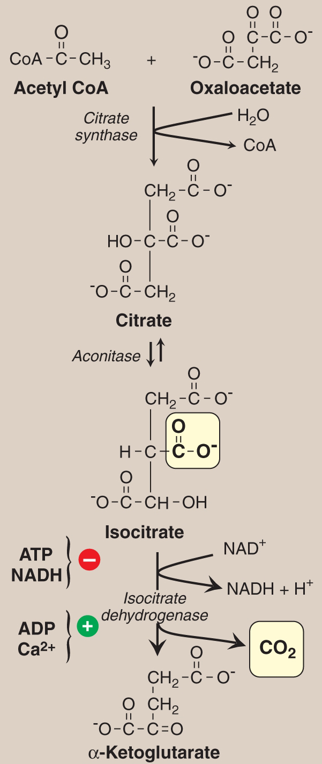
Formation of α-ketoglutarate from acetyl coA and OAA
aldol
condensation
isomerization
oxidative
decarboxylation

Slide 12
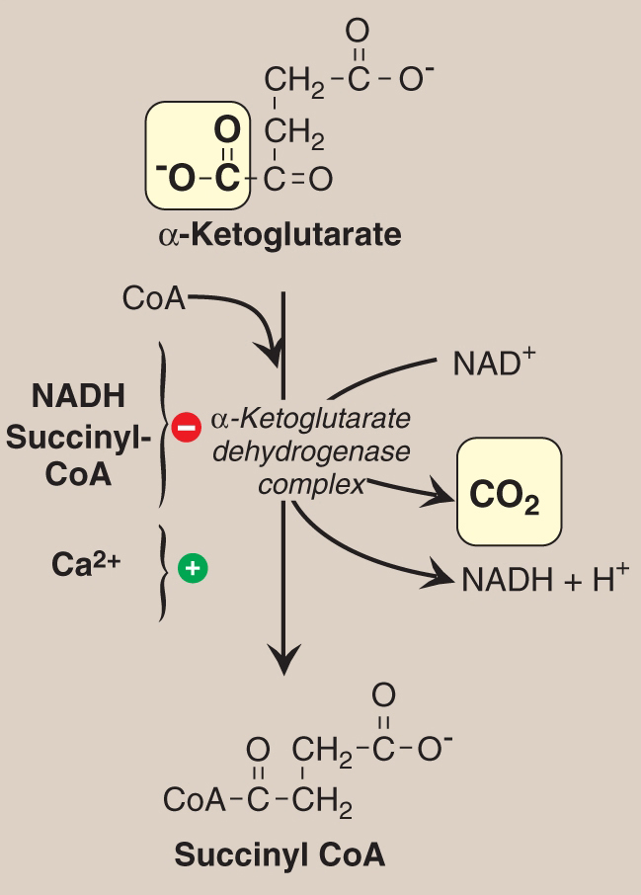
α-ketoglutarate dehydrogenase produces 2nd CO₂ and 2nd NADH of TCA cycle
oxidative
decarboxylation

Slide 13
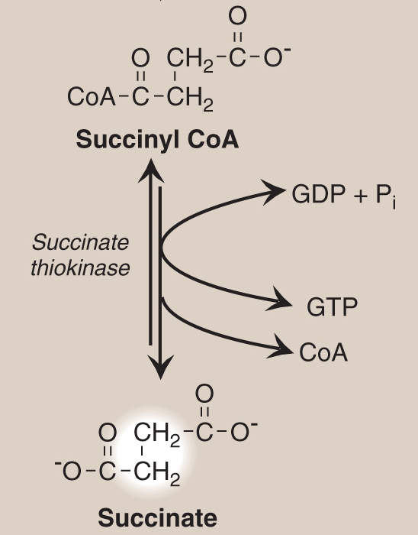
Succinyl coA cleavage results in substrate level phosphorylation
succinyl-CoA synthetase
succinate thiokinase
succinyl-CoA succinate + CoA
GDP + P_{i} GTP
Net reaction
Gº = -34 kJ/mol
ΔGº = +31 kJ/mol
ΔGº = -3 kJ/mol

Slide 14
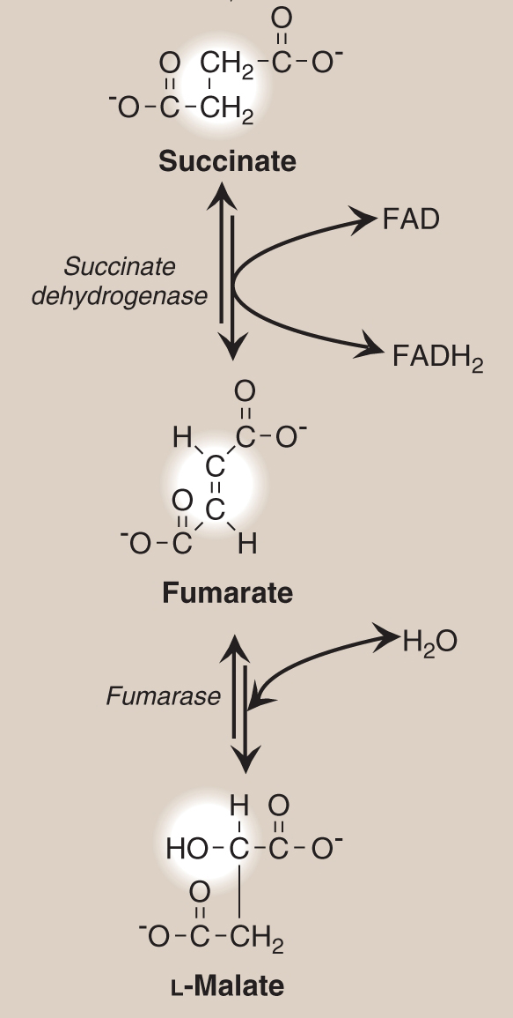
Conversion of succinate to malate in TCA cycle
oxidation
e¯
hydration

Slide 15
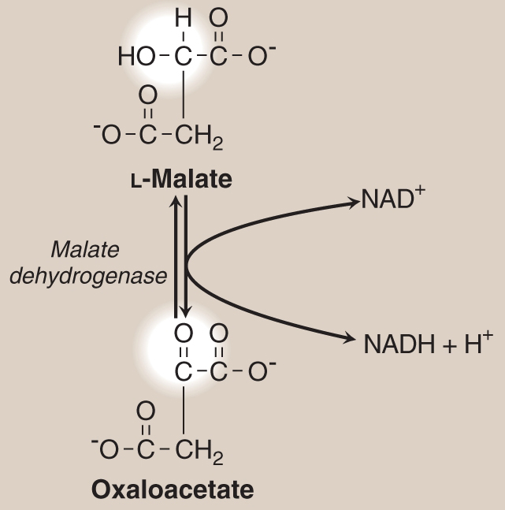
Formation of oxaloacetate from malate
Reversible oxidation reaction
oxidation
e¯
( 4 )

Slide 16
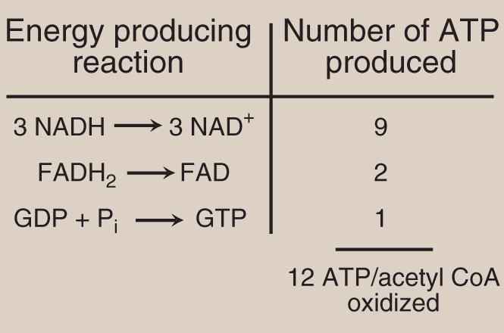
Number of ATP produced from the oxidation of one acetyl coA molecule
Four coenzyme molecules (NAD and FAD) are reduced per acetyl coA oxidized to CO₂.

